Slide 1
TuneFinder
The basics on how it works

Slide 2
What Is it? - Review
Website for finding songs by humming the melody
Shazam does very well for matching audio, but only works if you’re listening to the song currently
Other examples like SoundHound don’t work very well
Research topic – Machine Learning/Web Development

Slide 3
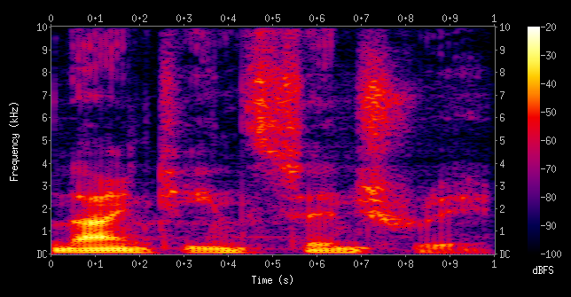
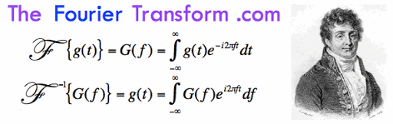
Spectrogram - which frequencies are happening at what times
Brighter means louder
Notes:
Spectrogram – Shows which frequencies are happening at what time
Good for finding the melody of music
Picture doesn’t help get the frequencies
-----
Fourier Transform helps quantify which notes are being played at what time where

Slide 4
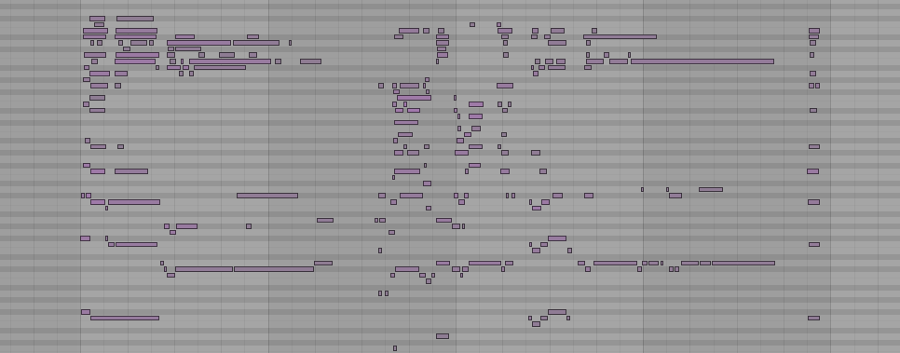
Waon
Notes:
Waon – Wav to Notes automates the process of changing audio to notes
----------
One artifact is that notes seem duplicated, these are natural harmonics being picked up, I need to work to figure out how to work around these
One way might be to look at just the lowest notes
----------
But sometimes the lowest notes is omitted, strange
----------
The golden zone is somewhere in this range, but it’s my task to either learn how to deal with these other notes, or find a way to find the main melody line among all this

Slide 5
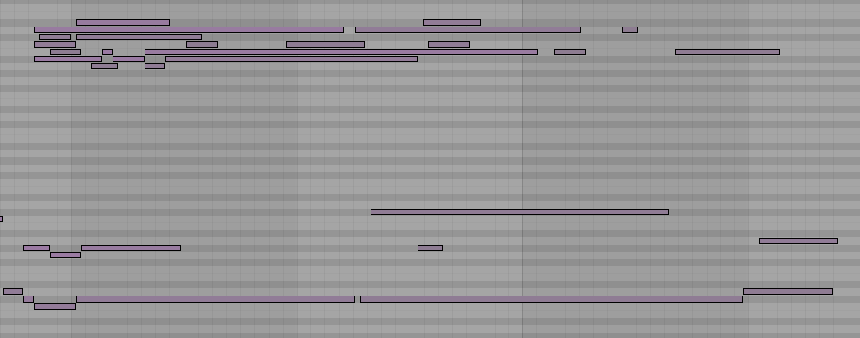
Features
Notes:
Once I have the midi, I can create a feature based on a time slice on the audio, think of it like the 6 spaces between the lines.
----------
I can average them together, and we get a note that doesn’t exist, which isn’t ideal, but if this is the way it behaves for all audio files that go through this transformation, then it should be self similar, and the model should train well
-----------
I could gather

Slide 6
What’s Next
Get it running on our website backend
Look at better methods of normalization
Examine ways to get rid of/deal with harmonics

